Slide 1
Using Gradient Descent to Optimize Paths for Sustaining Wireless Sensor Networks Srikanth K. V. Sudarshan and Aaron T. Becker Dept. of Electrical and Computer Engineering University of Houston, Houston, TX 70004, USA Email: skvenkatasudarshan@uh.edu, atbecker@uh.edu

Slide 2
Video of the sensor network dying

Slide 3
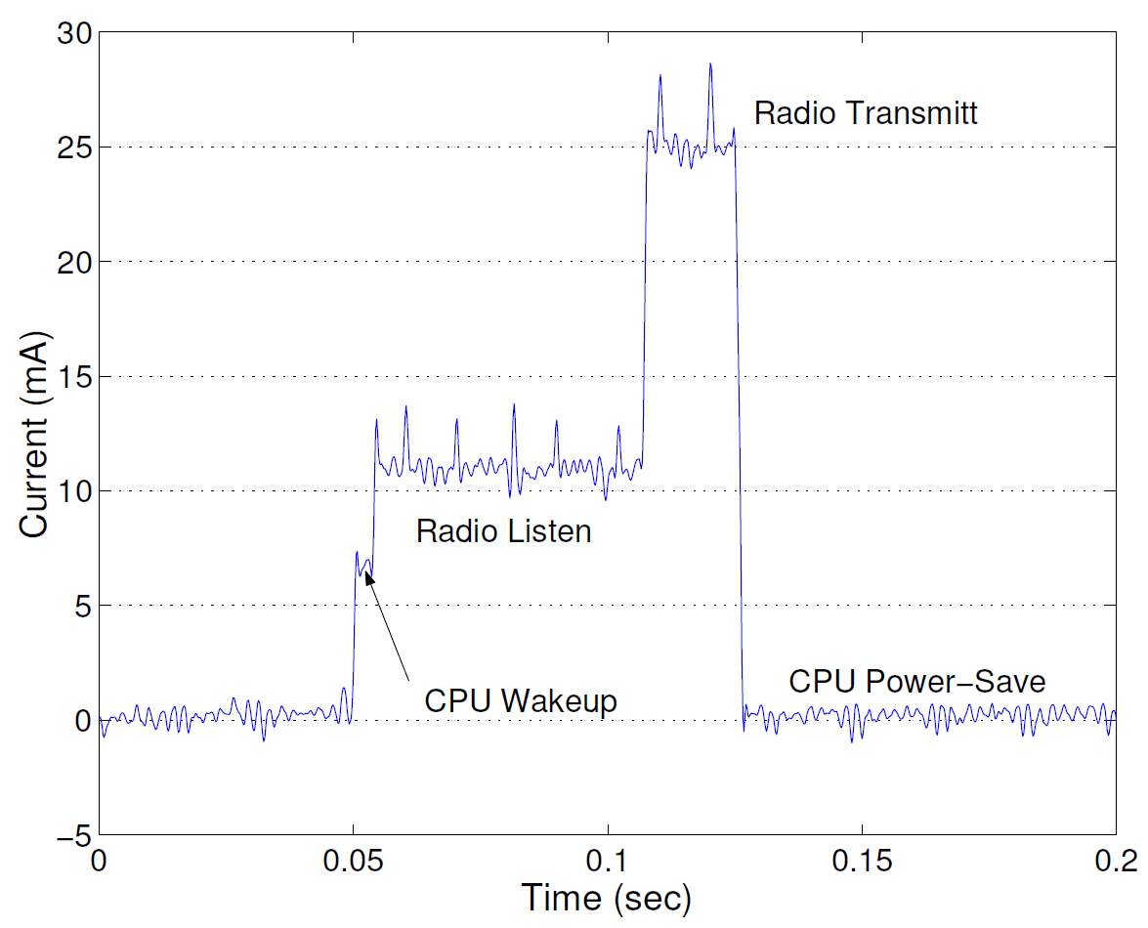
Current Usage in a Wireless Sensor Node
Different tasks that a wireless sensor node performs and the corresponding current usage is shown is the graph.
We observe, power usage in a wireless sensor node is dominated by transmission costs and listening costs.
Reference: Simulating the power consumption of large-scale sensor network applications, Victor Shnayder et. al., In ACMSensys, Baltimore, MD, November, 2004.

Slide 4
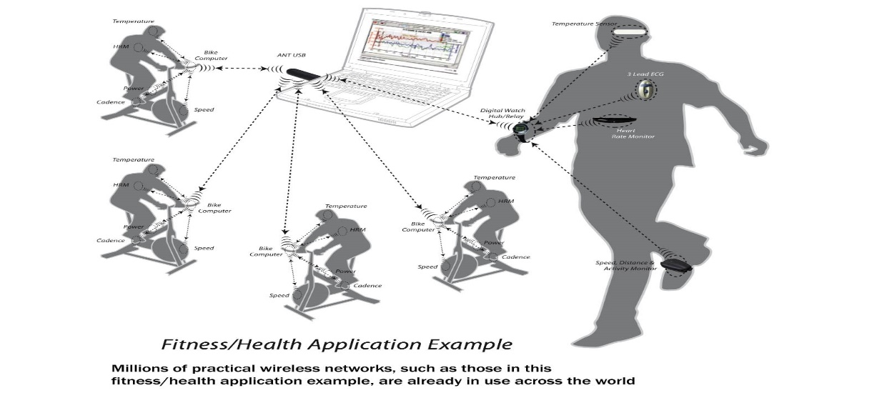
The Problem
A structural-health wireless sensor network (WSN) should last for decades, but traditional disposable batteries cannot sustain such a network.
Energy is the major impediment to sustainability of WSNs.
Most energy is consumed by :-
wireless transmissions of perceived data.
long-distance multi-hop transmissions from the source sensors to the sink.
By adapting techniques like Low Energy Adaptive Clustering Hierarchy (LEACH) we can only prolong the WSN’s operation but we can’t cannot extend it.
Hence we propose a novel idea that helps in sustaining the network without dying i.e. a method to recharge the batteries in a timely fashion and improving the energy efficiency.
For example imagine a man exercising and his heart rate is increasing and has reached an alarmingly high value and the sensor stops working due to lack of charge.
Or the sensors that detect enemy aircrafts entering our country stops working due to lack of charge it would become a catastrophe.
Sensors might be used to monitor crucial life sustaining parameters and if we do not acquire the necessary data it might turn out to be life threatening situation.

Slide 5






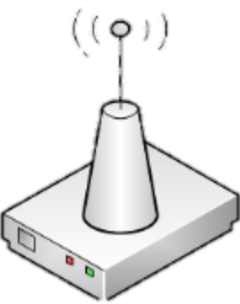
The Proposal
10101…
10101…
10101…
10101…
10101…
10101…
r_{recharge}
r_{data}
Traditional WSN
Dynamic path-planning
Evolution from traditional wireless sensor networks (WSNs) to servicing WSN with unmanned vehicles (UVs).
We present path-planning techniques that use UVs to gather aggregated data and recharge sensors by exploiting emerging wireless power transfer technology.
These UVs cut data transmissions from long to short-distances by collecting sensed information while replenishing WSN’s energy. We present a path-planning and path optimization algorithms for sustaining WSNs.

Slide 6
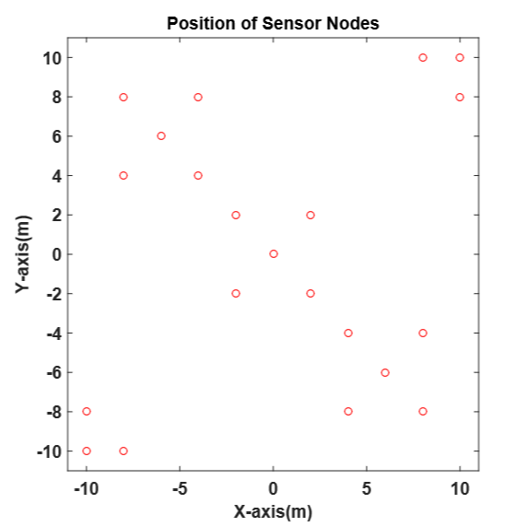
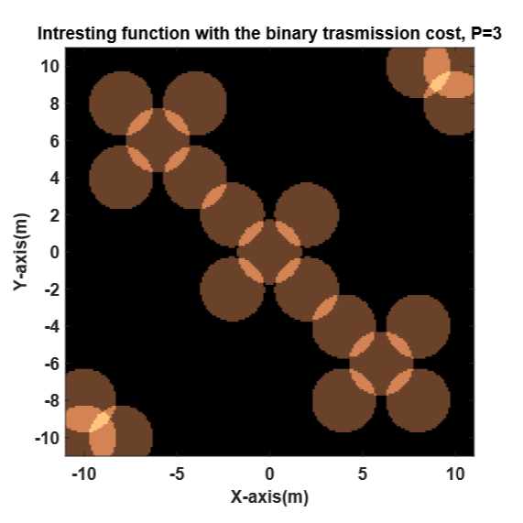
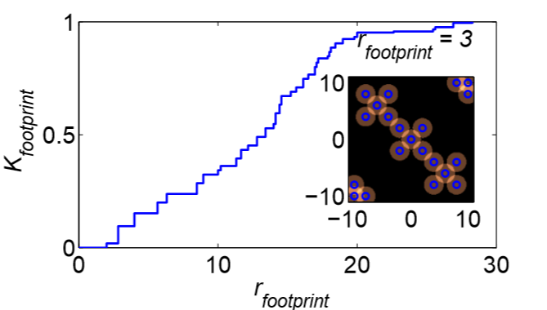
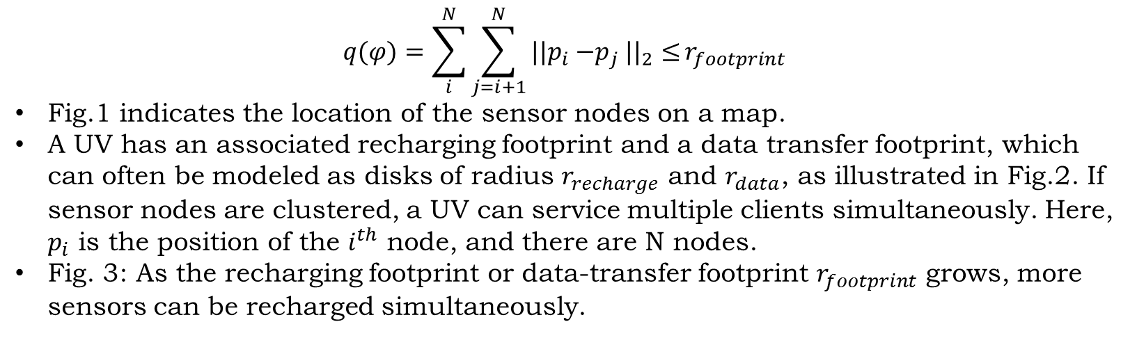
Footprint
$$q(φ)=\sum_{i}^{N}{{\sum_{j=i+1}^{N}{{{||p}_{i}{−p}_{j}||}_{2}≤}r}_{footprint} }$$
Fig.1 indicates the location of the sensor nodes on a map.
A UV has an associated recharging footprint and a data transfer footprint, which can often be modeled as disks of radius $r_{recharge}$ and $r_{data}$, as illustrated in Fig.2. If sensor nodes are clustered, a UV can service multiple clients simultaneously. Here, $p_{i}$ is the position of the $i^{th}$ node, and there are N nodes.
Fig. 3: As the recharging footprint or data-transfer footprint $r_{footprint}$ grows, more sensors can be recharged simultaneously.

Slide 7
Video of one robot path planning

Slide 8
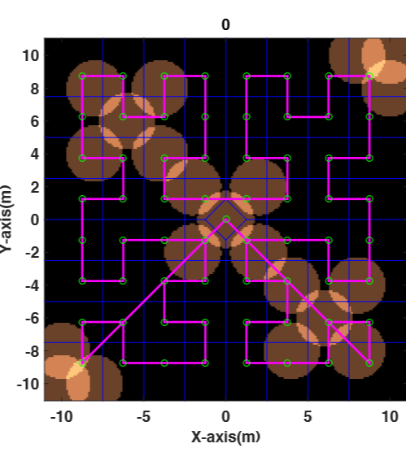
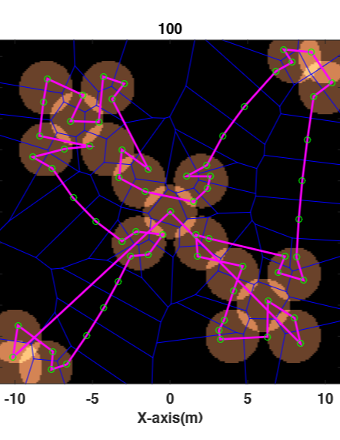
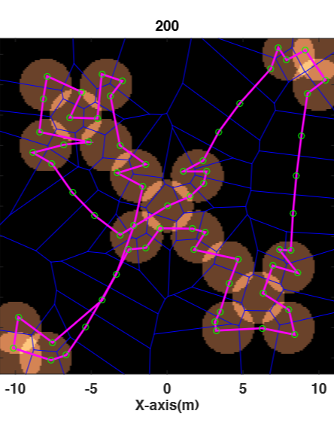
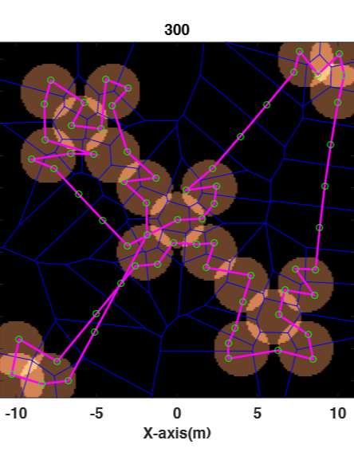
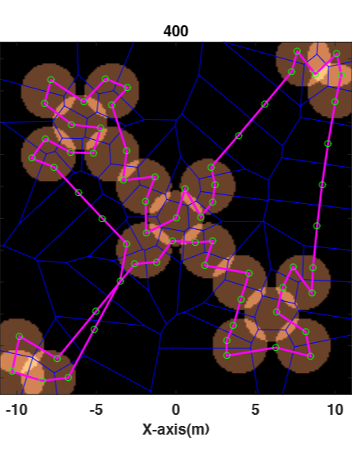
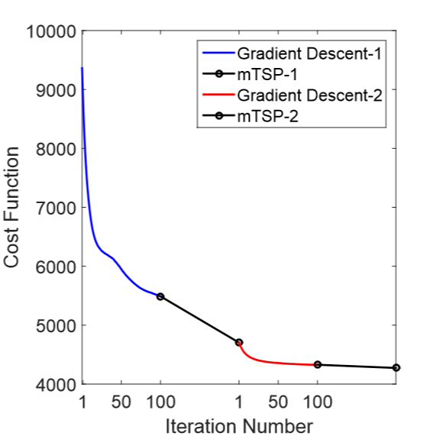
Results for the One Robot Case

Slide 9
Video of two robot path planning

Slide 10
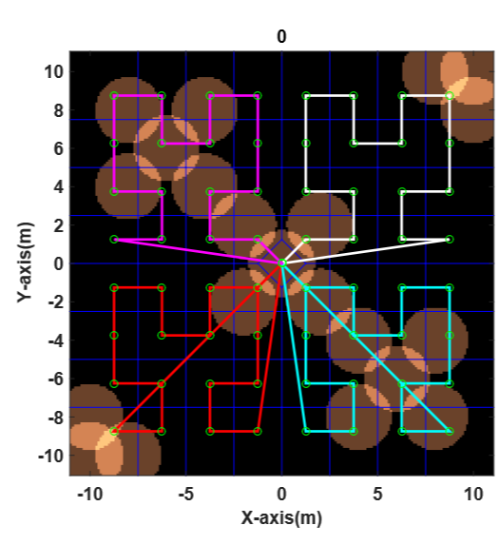
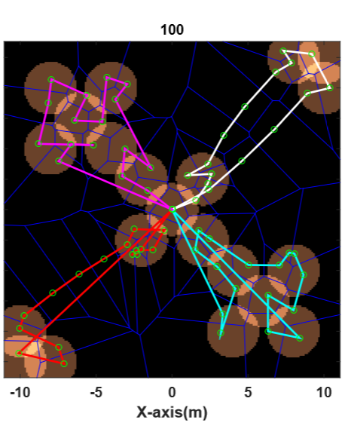
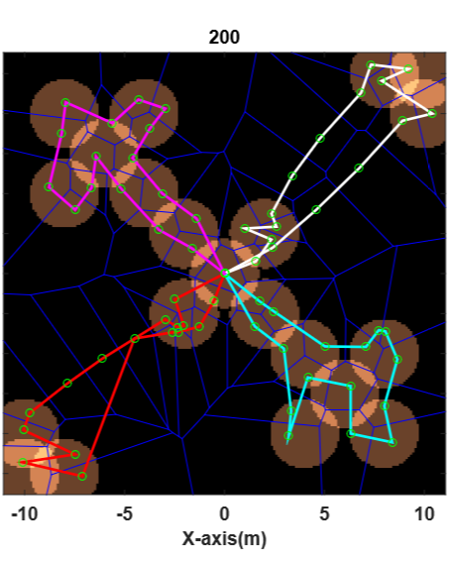
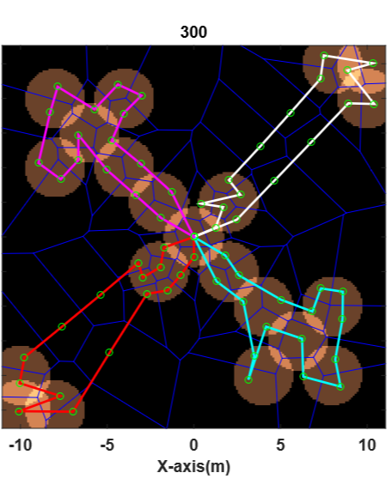
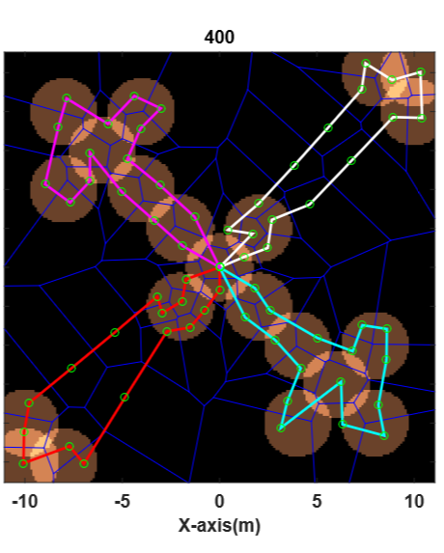
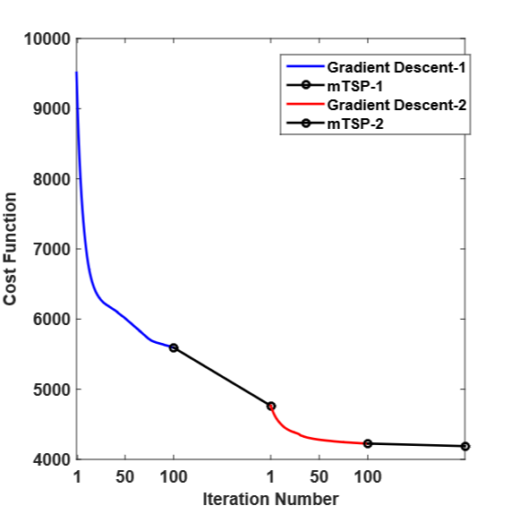
Results for the Multi Robot Case

Slide 11
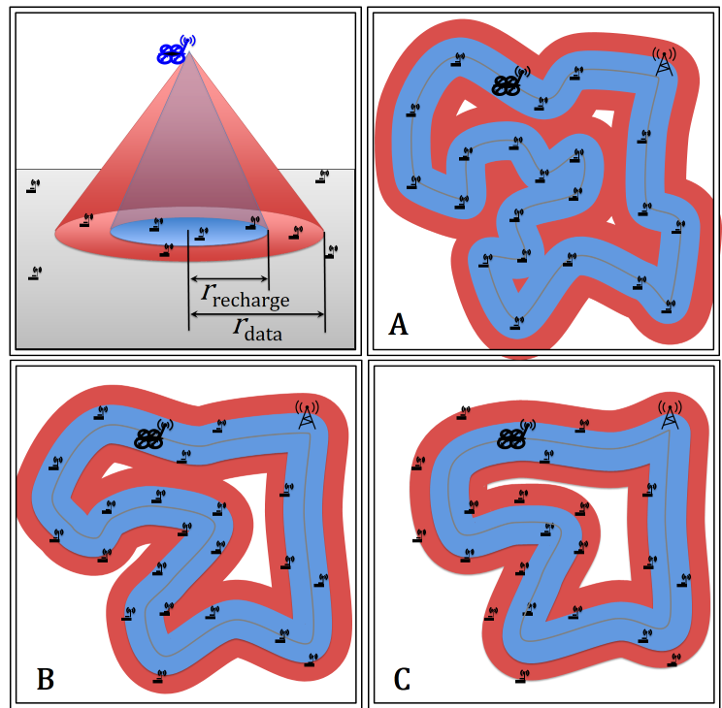
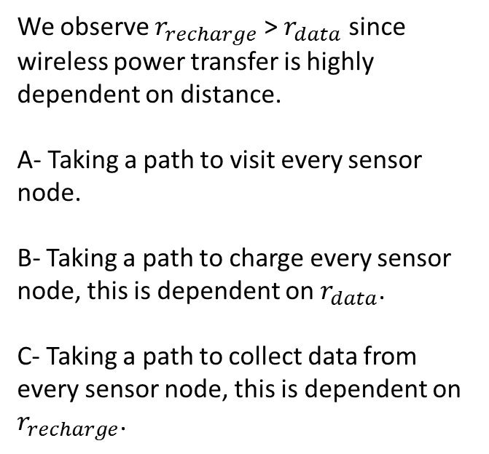
Schematic representation of the Distance travelled
We observe $r_{recharge}$ > $r_{data}$ since wireless power transfer is highly dependent on distance.
A- Taking a path to visit every sensor node.
B- Taking a path to charge every sensor node, this is dependent on $r_{data}$.
C- Taking a path to collect data from every sensor node, this is dependent on $r_{recharge}$.

Slide 12
Algorithms

Slide 13
mTSP - (multiple Travelling Salesman Problem)

Slide 14
Conclusion
An optimized path-planning algorithm was simulated for servicing a WSN and the path constructed is adaptive to the sensor node locations.
Two algorithms are used for obtaining the desired result.
First algorithm performs a Gradient descent to the cost function and is dependent on the interesting region and the distance between neighboring waypoints.
Second algorithm is a mTSP solver which helps in optimizing the solution further and helps in escaping from a local minima.
The results were simulated with single and multi-robots for a static WSN.

Slide 15
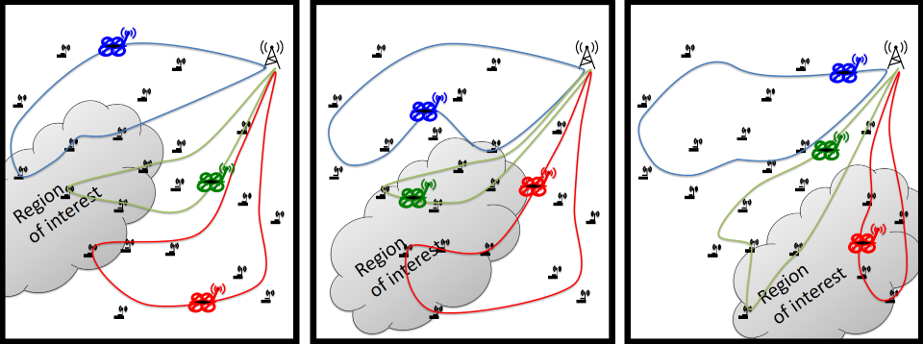
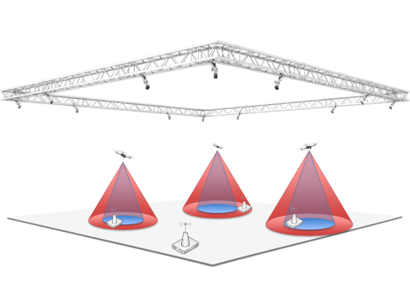
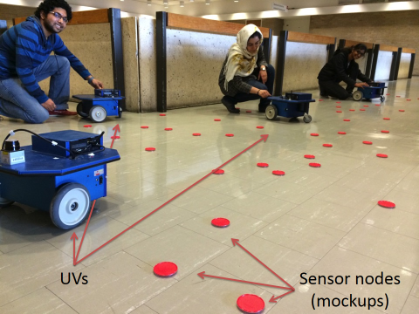
Future Work
Should extend our simulation to handle non-stationary sensor nodes.
Improve the convergence rate by adapting other optimization techniques.
Use our mTSP code to escape local minima for non-stationary nodes.
We are in the process of implementing the algorithm on mobile-robots, with eventual implementation with a set of quadcopters.
The grey cloud represents a time-varying region of interest. Allowing the UVs to dynamically modify their routes in a distributed manner enables a robust response to changing conditions while maintaining service.

Slide 16




THANK YOU
Baylor University University of Houston Dr.Aaron.T.Becker
QUESTIONS

